Slide 1


ADF Examples
Wake Forest
School of Business
_______

Slide 2
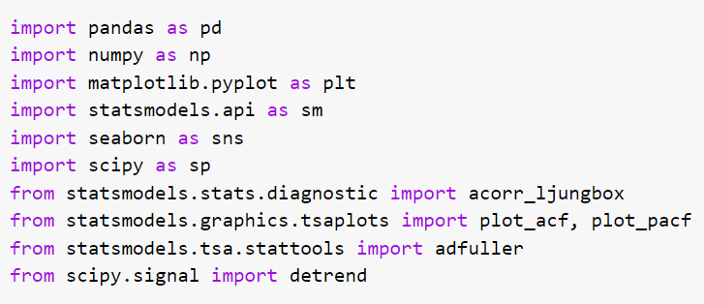
Python Implementation
Augmented Dickey Fuller Test
adfuller function from statsmodels
Use regression option to select correct hypotheses
‘c’: single mean
‘ct’: trend
‘n’: zero mean
Removing linear trend (de-trending)
Use detrend function from scipy

Slide 3
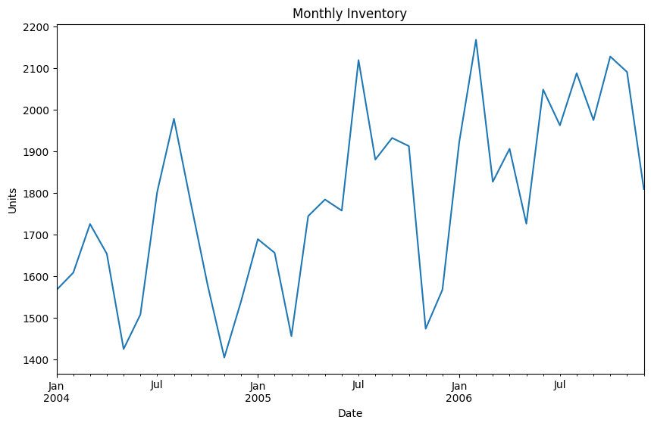
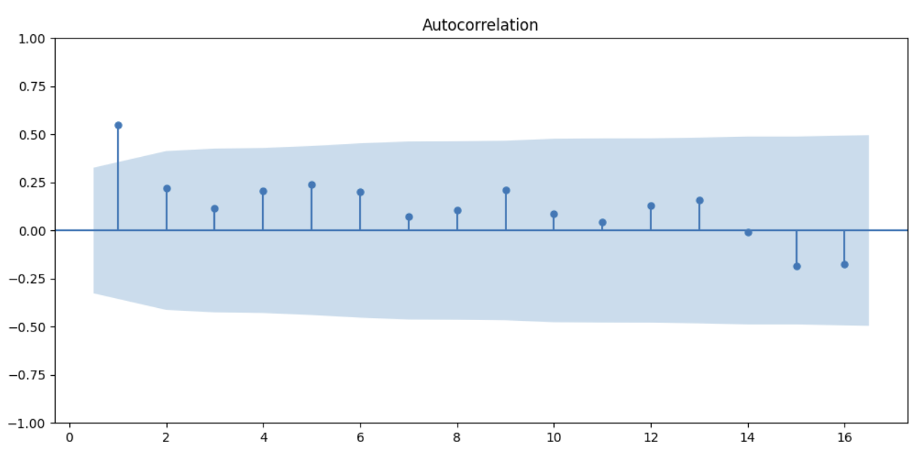
Monthly Inventory (Stationary)

Slide 4
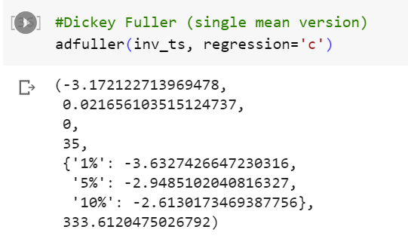
Monthly Inventory (Stationary)

Slide 5
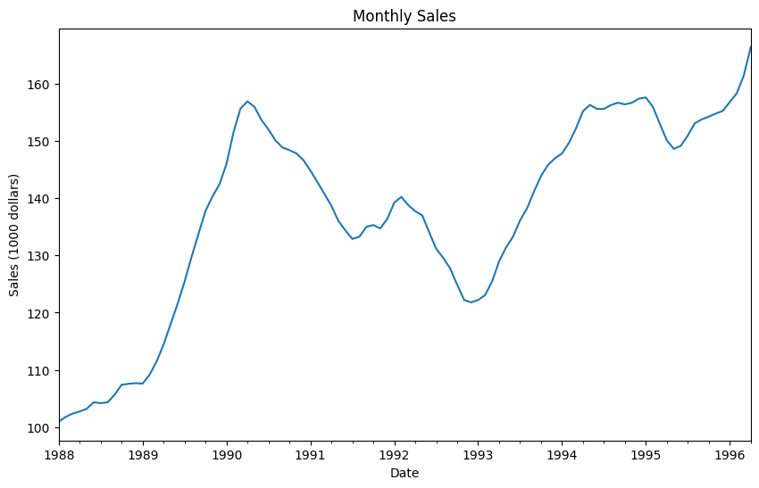
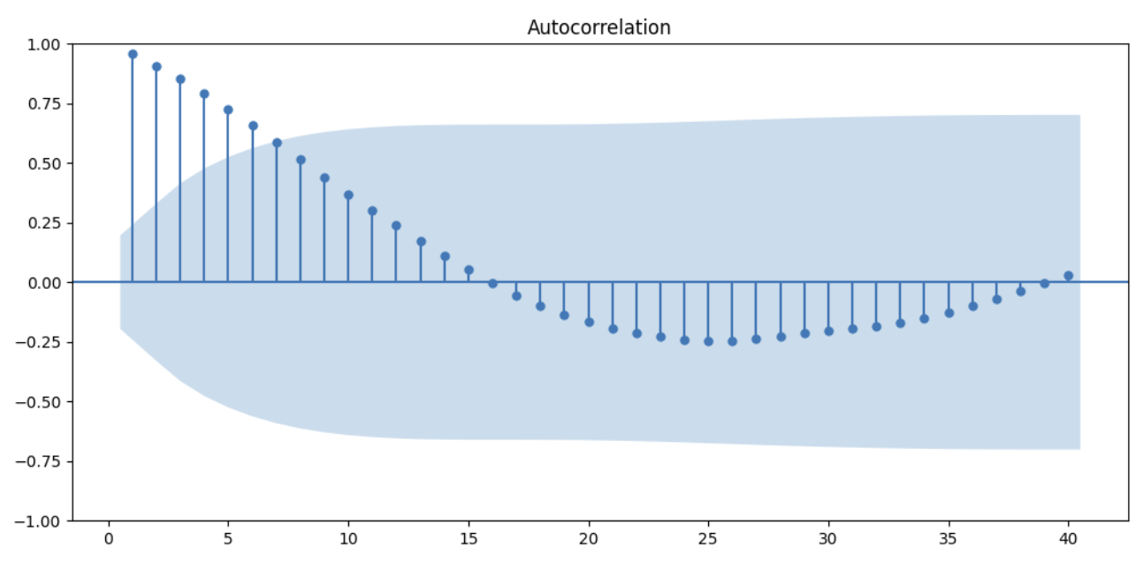
Sales Series (Nonstationary)

Slide 6
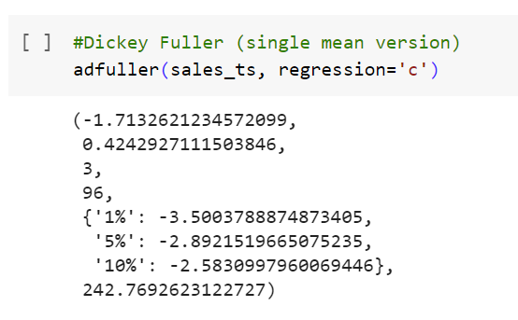
Sales Series (Nonstationary)

Slide 7
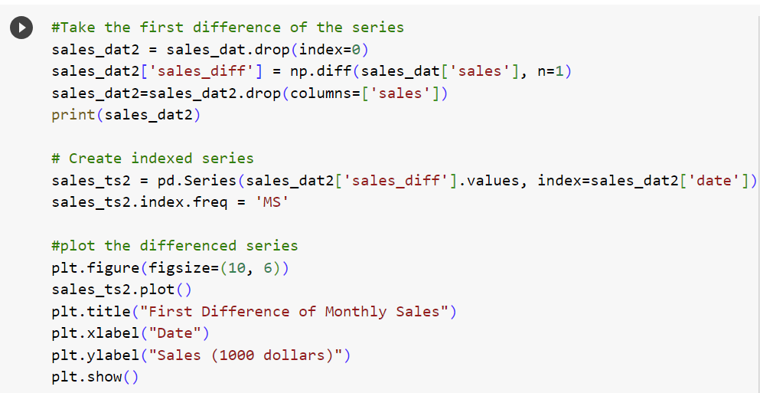
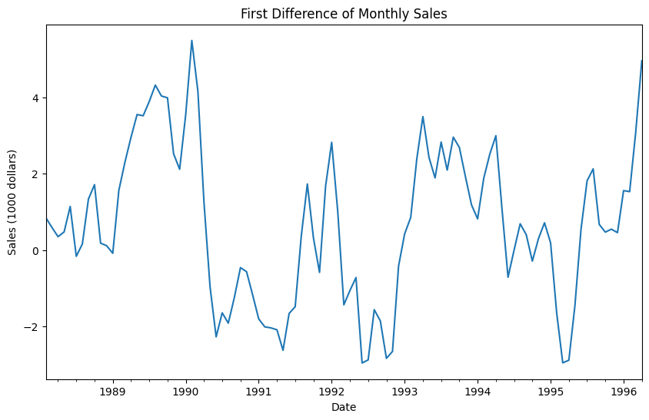
Sales Series (First Difference)

Slide 8
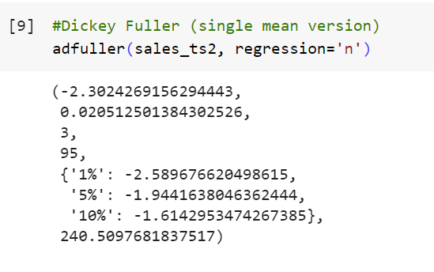
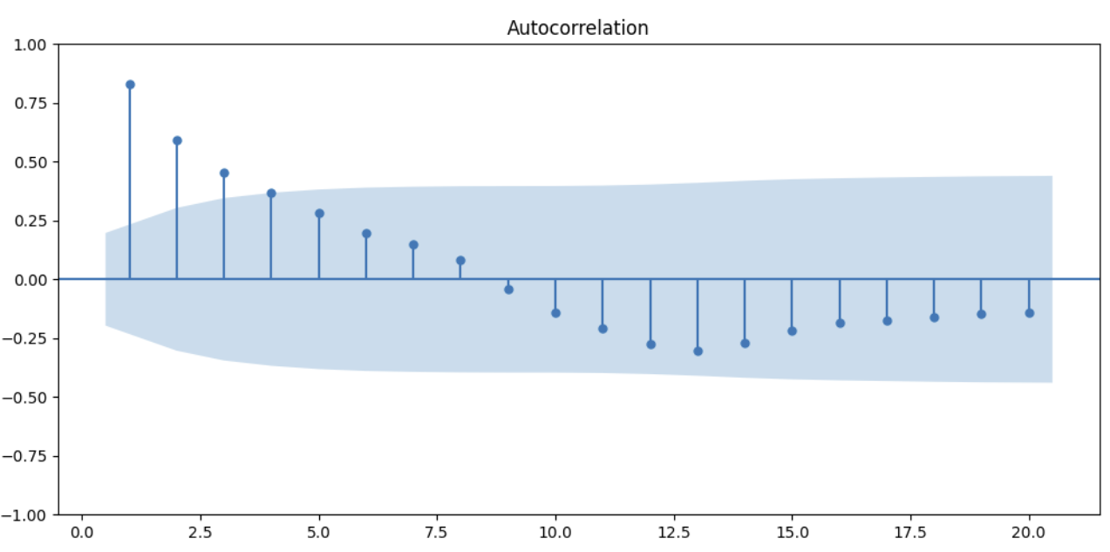
Differenced Sales Series (Stationary)

Slide 9
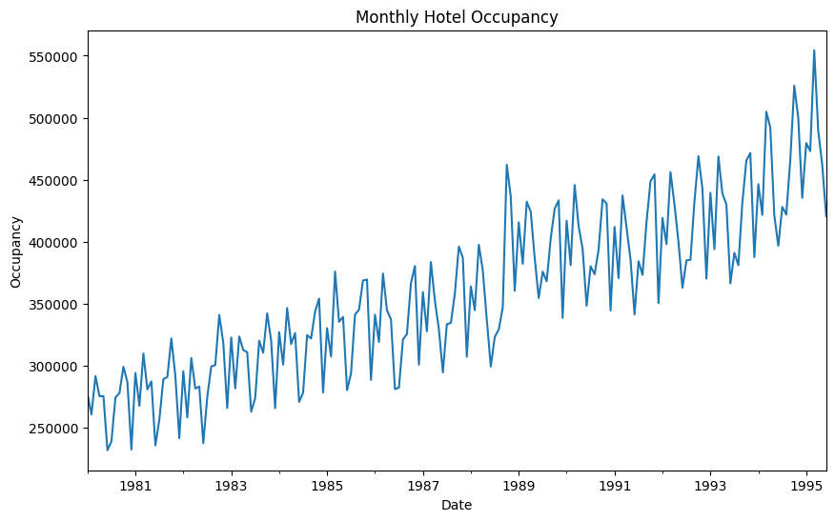
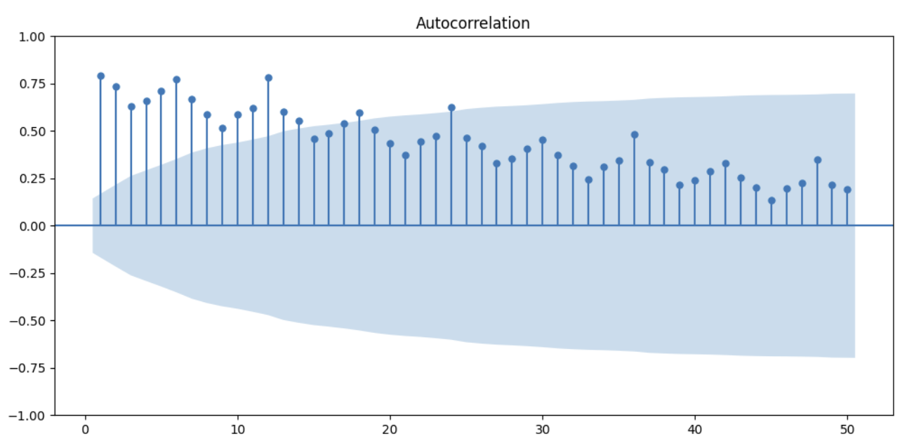
Hotel Occupancy Series (Trend Stationary)

Slide 10
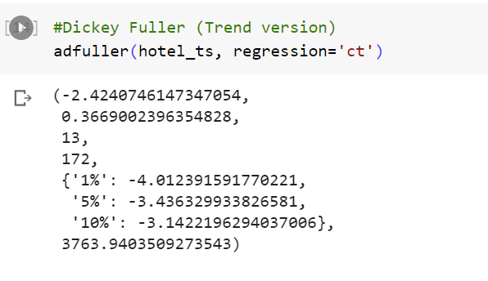
Hotel Occupancy Series (Trend Stationary)

Slide 11
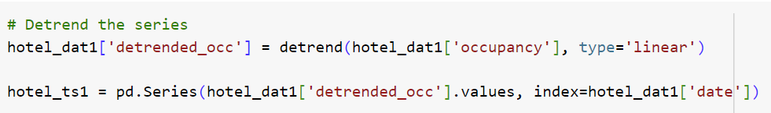
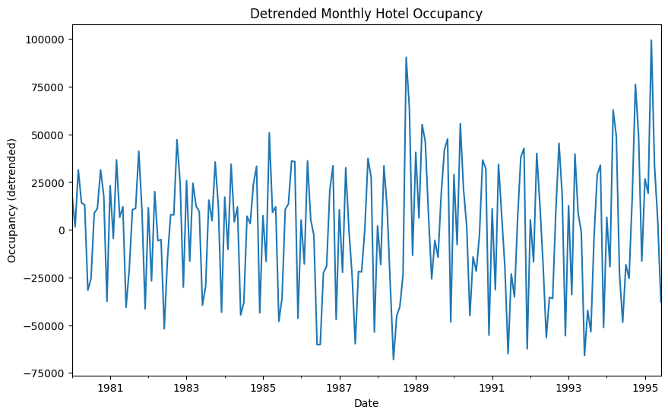
Hotel Occupancy Series (Detrended)

Slide 12
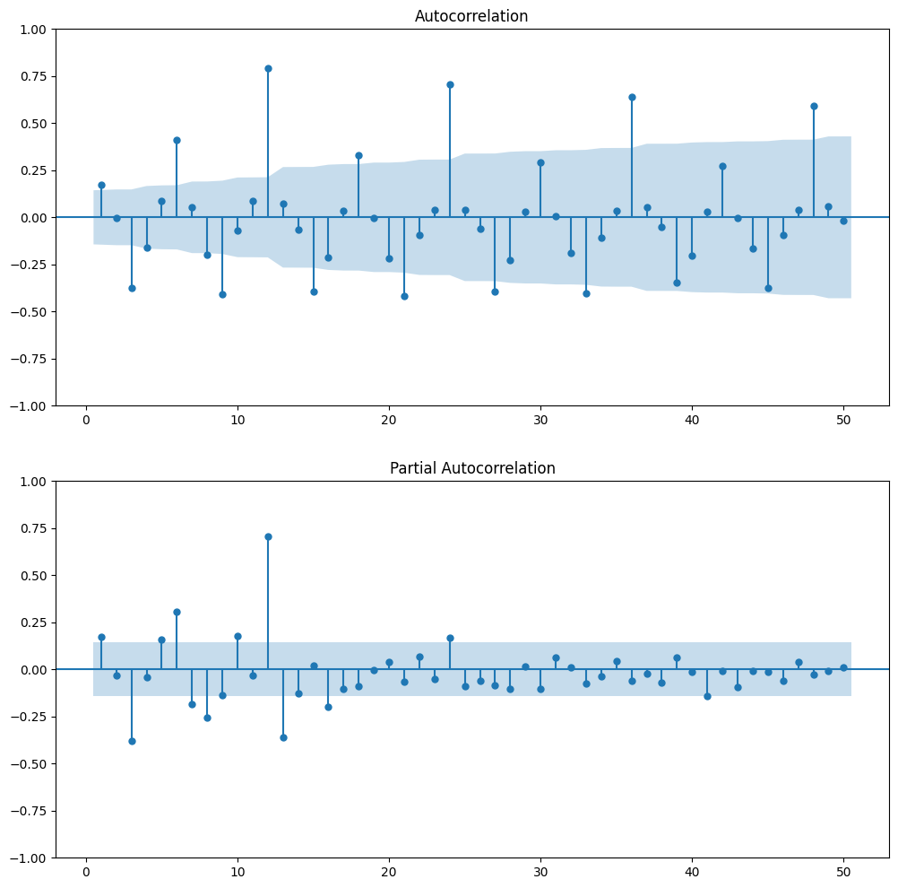
Hotel Occupancy Series (Detrended)

